Slide 1
Using Geographic Data to Find Prospect Locations for New Fitness Centers in the City of Waterloo, Ontario
Lucas Lau

Slide 2
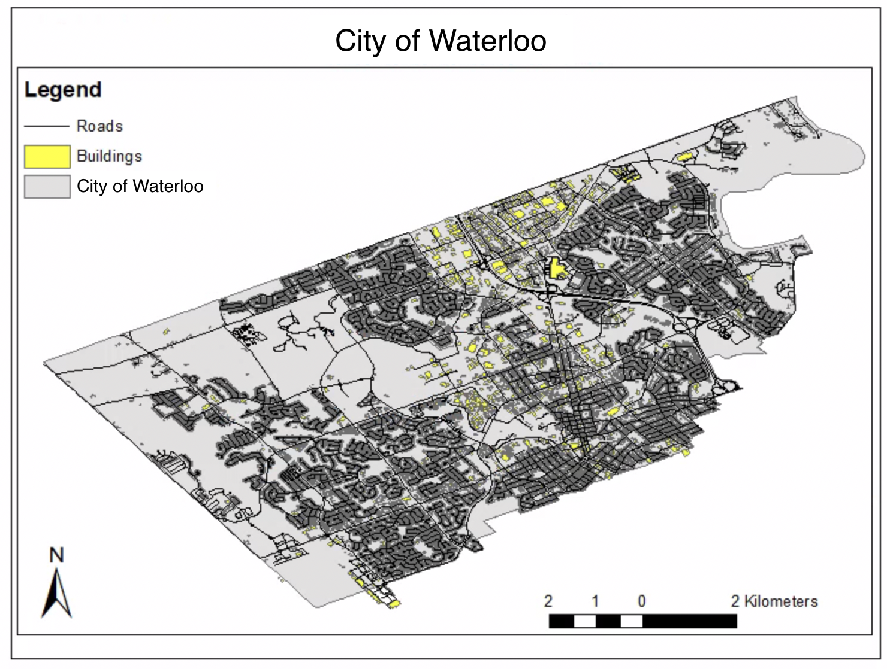
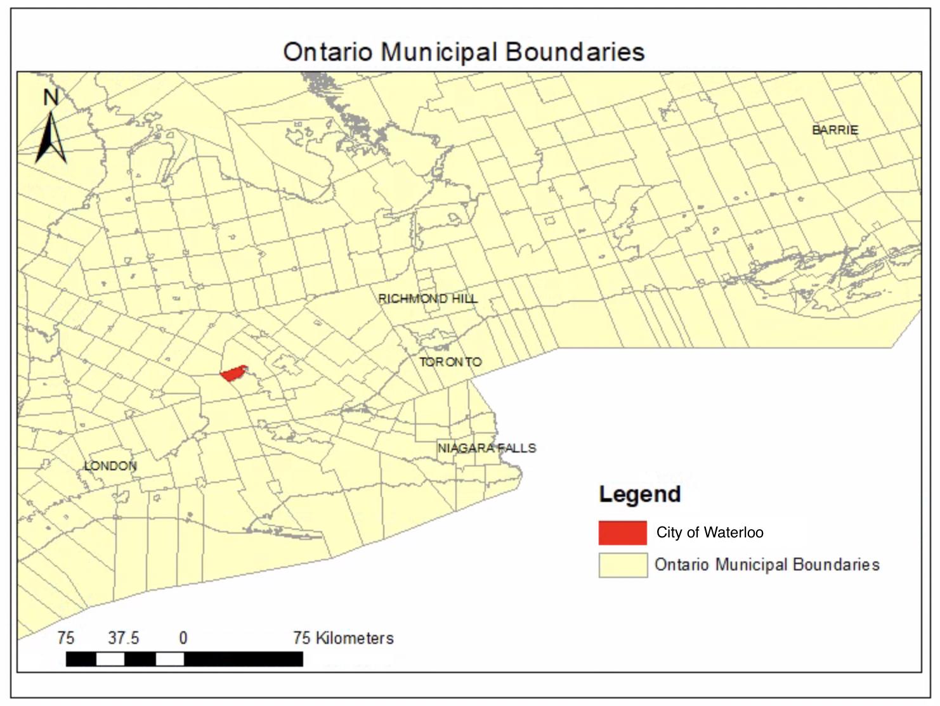
Study Area

Slide 3
Data
Ontario and City of Waterloo Open Data
Population
Population density
Roads
Land use
Transportation
Building
Google Maps
Existing fitness centers

Slide 4
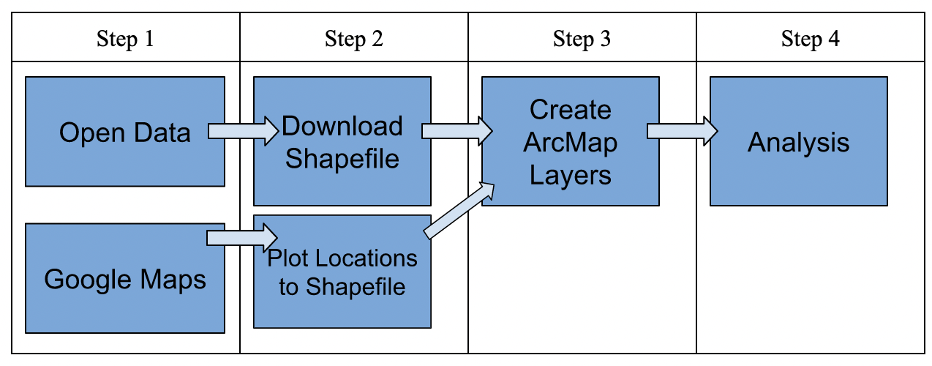
Data

Slide 5
Analysis
Boolean model positioning method
Stringent, selected locations have greater potential
Our data consists of many layers
Results help us answer research question

Slide 6
Results
Both prospective locations and non-suitable locations for new fitness centers will be identified
Resulting prospect locations will only include areas that are
easily accessible
nearby residential areas
not next to any pre-existing fitness centers
NOTE: Final result can vary depending on the weights that are assigned in each raster and how many factors are accounted for

Slide 7
Study:
Identify Potential Artificial Groundwater Recharge Zones in Northwestern Saudi Arabia
Accounted for six (6) factors
slope, soil texture, vadose zone thickness/depth to water table, groundwater quality, type of water bearing formation, and land use/land cover
Results
17.90% of the total study area was suitable for recharge without taking in consideration the land use/land cover pattern
14.24% of the total study was suitable for recharge after considering land use/land cover pattern

Slide 8
Discussion
Current study: Find prospect locations for new fitness centers in the City of Waterloo
Potential broad implications of the boolean model positioning method
Identify suitable areas to grow more vegetation (i.e. trees)
Identify potential artificial groundwater recharge zones

Slide 9
Limitations, Issues, and Constraints
Depends solely on the number of factors that are considered in the operation
All the layers need to be converted to a raster which can cause the data to be less accurate after the transformation
Only outputs results in binary - 1’s and 0’s - which eliminates partial suitability

